Slide 1

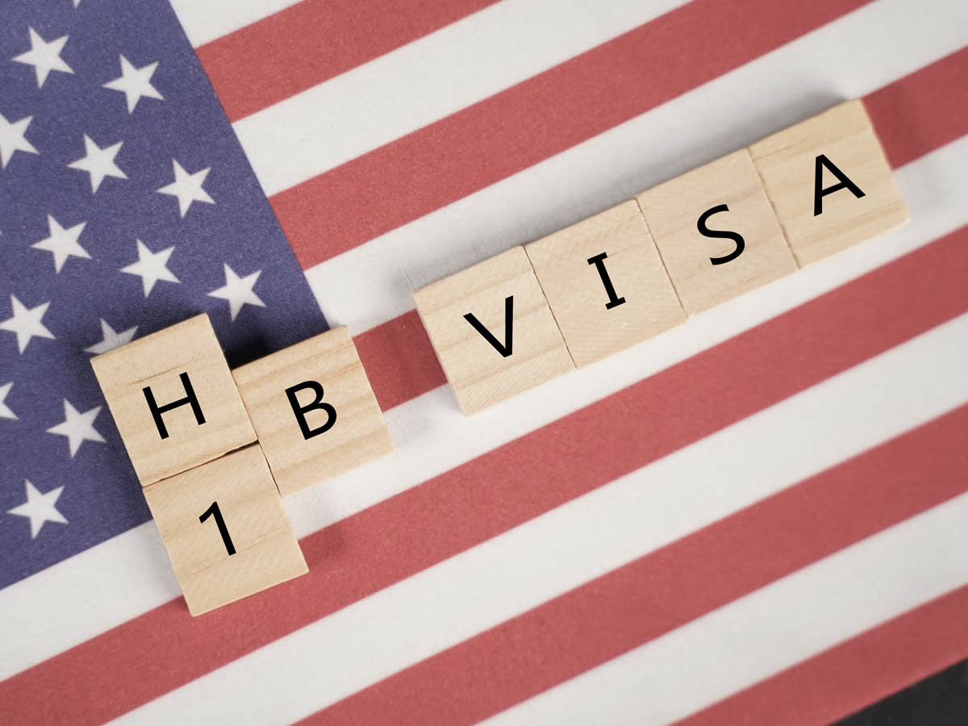
The Race to Work Visa (Analysis on H1B approvals)
MSIS642 Multivariate Statistics and Regression Analysis
Fall 2020
Alisha Warke

Slide 2

Immigration law in the United States has been built upon the following principles:
the reunification of families, admitting immigrants with skills that are valuable to the U.S. economy, protecting refugees, and promoting diversity.

Slide 3

Why H-1B matters
Outline
What is H1B?
The H-1B is a visa in the United States under the Immigration and Nationality Act, section 101(a)(15)(H) that allows U.S. employers to temporarily employ foreign workers in specialty occupations.
Several studies have revealed that immigrants actually help bridge the skills gap plaguing several industries in the US, including big tech and healthcare.
So H1B is the work permit for international workers and there have been quite a few discussions around it in the past few years.
Will be looking at the insights:
Effect of city/state on the approval and denial of H1B.
Effect of salary on the approval/denial of H1B.
Effect of the dependents on the approval/denial.
Agenda

Slide 4

Motivation
“Denial rates for new H-1B petitions for initial employment rose from 6% in FY 2015 to 29% through the second quarter of FY 2020,” according to a National Foundation for American Policy analysis.
On June 22, 2020, President Trump made an executive order, now generally referred to as the H1B visa ban.
An uproar from the immigration community as well as many large tech companies like Facebook and Microsoft, who rely on skilled foreign workers. As a result, the Department of State has announced certain relaxations and exceptions to the H1B visa ban.
The Department of State said the reason for certain exceptions being allowed is because replacing certain critical employees will cause financial hardship to businesses.

Slide 5
Literature Review : Facts!
H1B Specialty Occupation - the rapid changes to the H1B rules.
bachelor’s or higher degree specifically related to the Specialty Occupation
position they will be hiring in is directly related to the education degree.
DHS wants to use the conventional “master-servant relationship.”
The employer petitioning for the H1B visa must essentially control and evaluate the work done by the H1B visa holder.
hire, pay, provide equipment for work, and claim them as an employee for tax purposes.
delivered product has to be related to the employer’s usual line of work.
At a third-party worksite, the DHS will require additional evidence to prove this relationship like Statement of Work, Supplier Agreements, etc

Slide 6

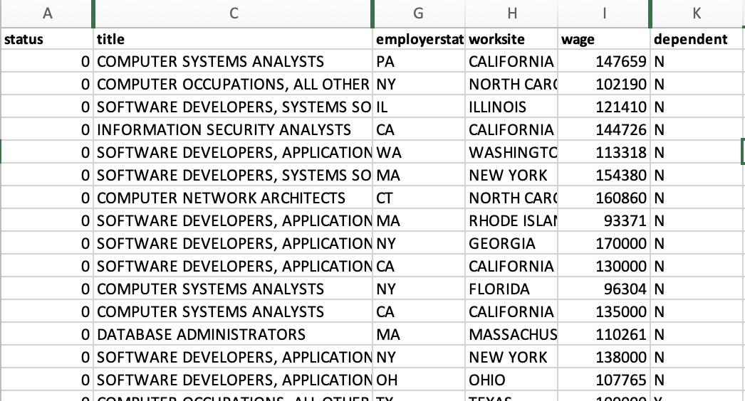
Data
Data Source: Performance Data from the U.S Department of Labor site
https://www.dol.gov/agencies/eta/foreign-labor/performance
Description: The data includes variables such as :
Status - Accepted (0) / Denied (1)
wage - Yearly salary
Title - To include all the IT jobs
Employer State - EMployer’s primary location
Worksite - Employee’s work location
Dependent - If the employer is designated as H1B dependent

Slide 7

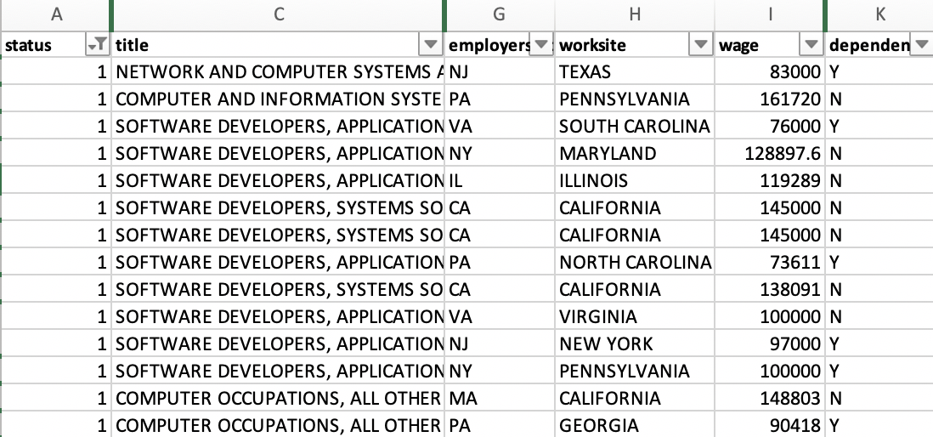
Data (cont.)
Summary: The data is selected to include only to analyze the effect of few factors (independent variables) on the status (Dependent Variable) of the Acceptance or Rejection of the visa.
The variables considered as Independent variables are:
Wage - Effect of yearly salary on the rejection of visa.
Worksite (State) - Effect of employee state on the rejection of visa.
Dependent - Effect of employer being H1B dependent (15%+ of workforce) on the denial of visa.

Slide 8

Theory and Hypothesis
Theory
The primary purpose of the recent H1B changes is to better ensure that each H-1B nonimmigrant worker (H-1B worker) will be working for a qualified employer in a job that meets the statutory definition of a “specialty occupation.”
Now, What is the probability of wage or the worksite on the status of H1B.
Hypothesis:
H0 : It is a lottery system.
Ha: Is there an effect on wage on the denial of the visa?
Ha: Is there an effect of worksite on the denial of the visa?
Ha: Is there an effect of employer being H1B dependent on the denial of the visa?

Slide 9

Empirical Approach

Slide 10
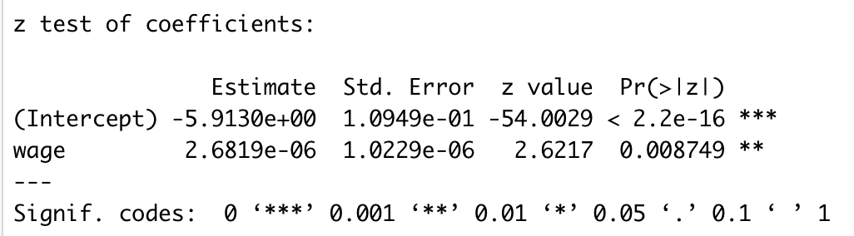
# Regressing the status on the wage
H1Blogit <- glm(status ~ wage,
family = binomial(link = "logit"),
data = H1B)
coeftest(H1Blogit, vcov. = vcovHC, type = "HC1")

Slide 11

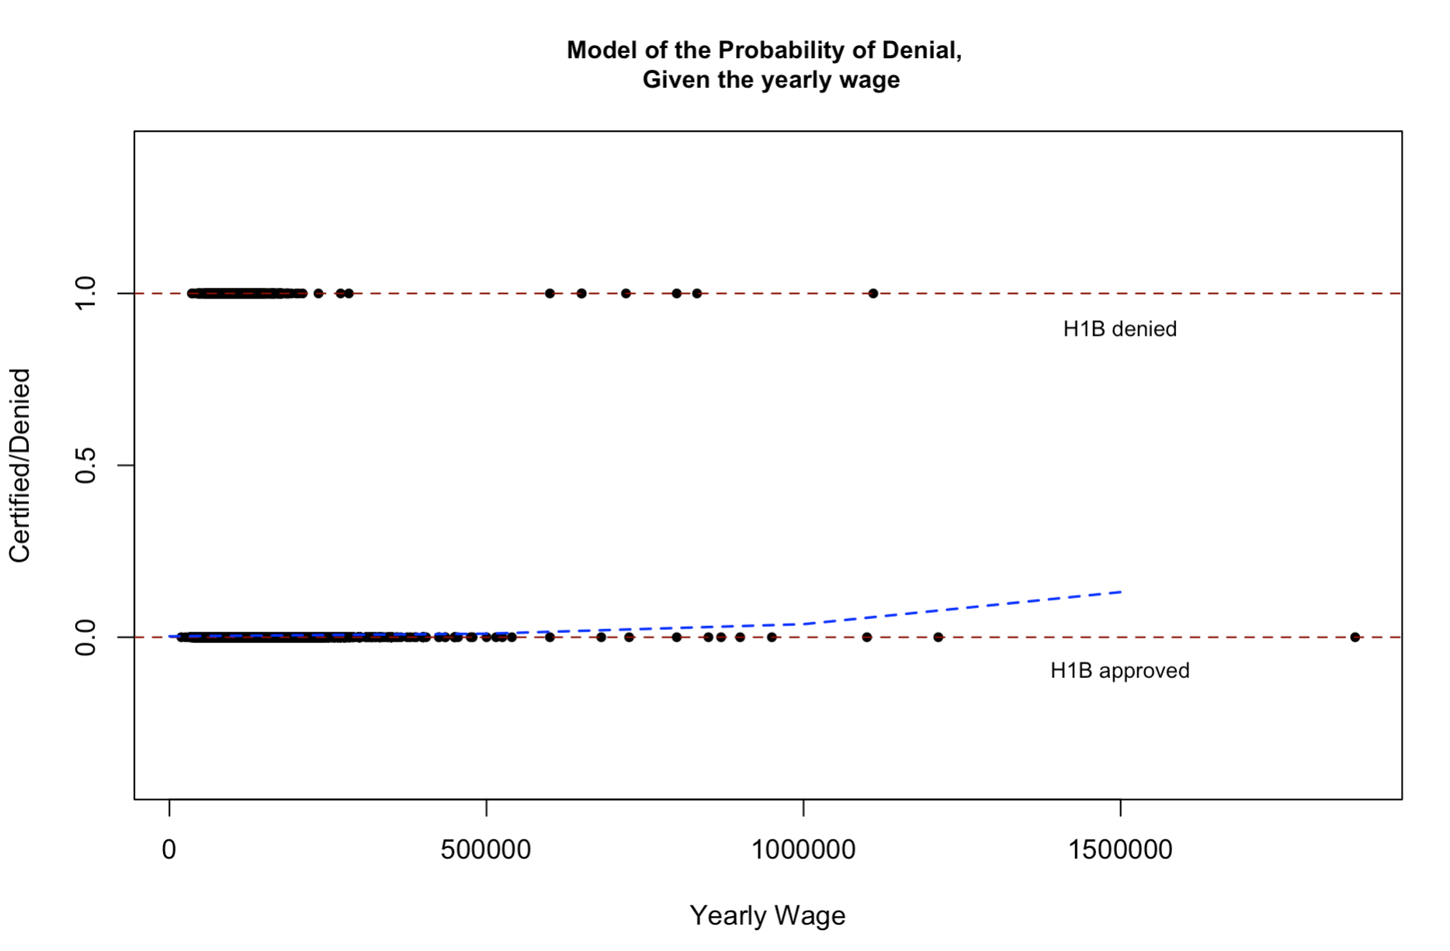

Slide 12
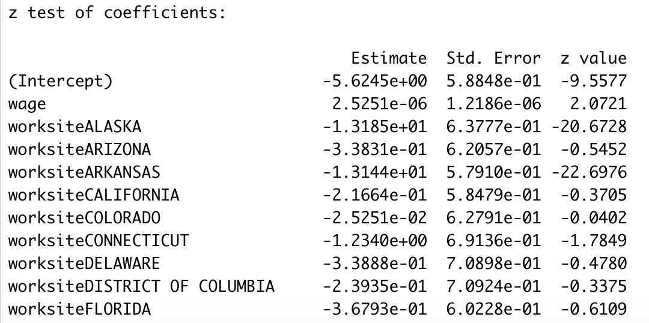
# Regressing the status on the wage and worksite
H1Blogit2 <- glm(status ~ wage + worksite,
family = binomial(link = "logit"),
data = H1B)
coeftest(H1Blogit2, vcov. = vcovHC, type = "HC1")

Slide 13
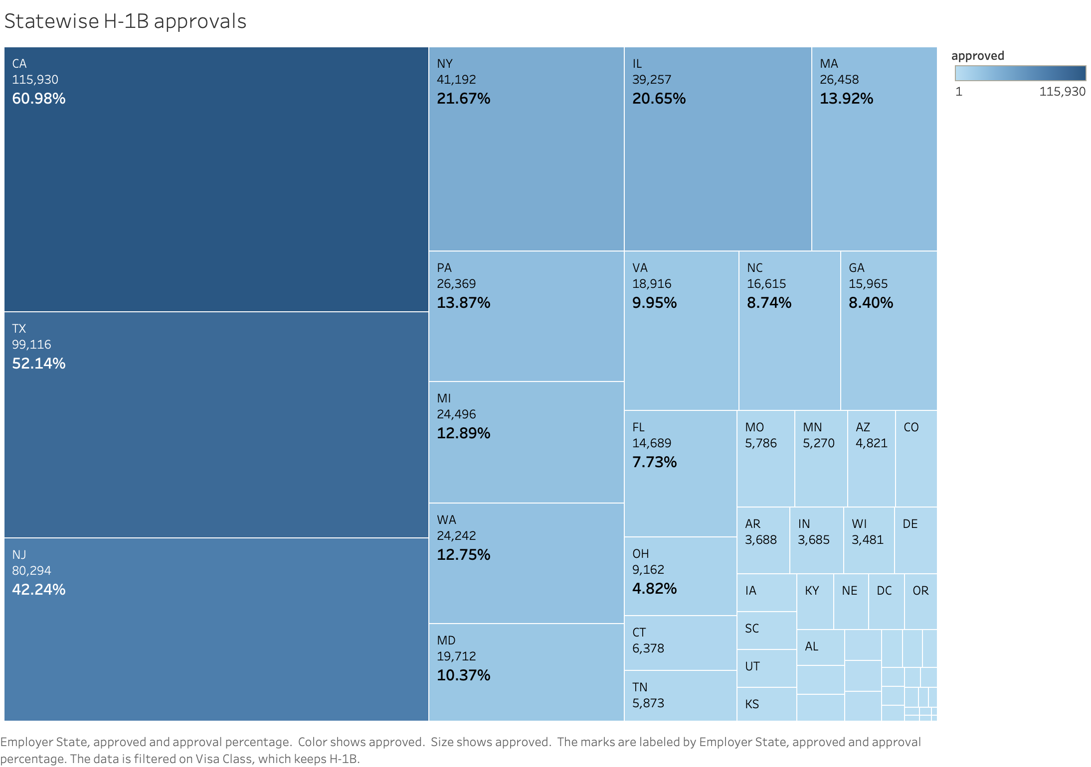
Petitions filed
418,799 in 2018 to
420,549 in 2019.
Petitions approved
332,358 in 2018 to
388,403 in 2019
Median salary
$95,000 for 2018 to
$98,000 for 2019.

Slide 14
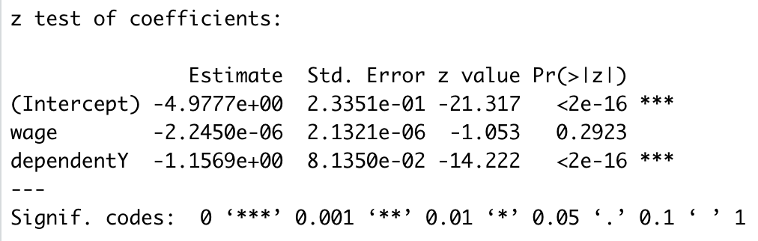
# Regressing the status on the wage and dependent
H1Blogit3 <- glm(status ~ wage + dependent,
family = binomial(link = "logit"),
data = H1B)
coeftest(H1Blogit3, vcov. = vcovHC, type = "HC1")

Slide 15
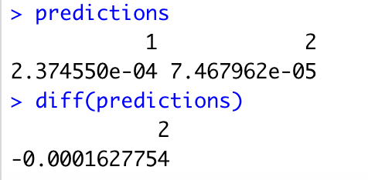
# Regressing the status on the wage and dependent
predictions <- predict(H1Blogit3,
newdata = data.frame("dependent" = c("N", "Y"),
"wage" = c(1000000, 2000000)),
type = "response")
predictions
diff(predictions)
The difference in probabilities of denial for H1B dependent employers to not being dependent is 0.016% (with probability of denial for dependent employers greater)

Slide 16
Empirical Approach
The Linear Approach

Slide 17
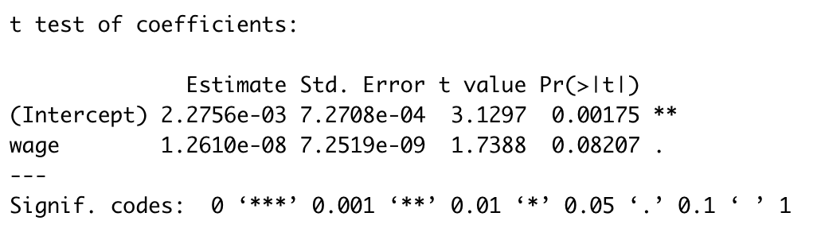
# Regressing (Linear) the status on the wage
H1Bmodel <- lm(status ~ wage,
data = H1B)
coeftest(H1Bmodel, vcov. = vcovHC, type = "HC1")
The linear probability model has a major flaw:
It assumes the conditional probability function to be linear.
This does not restrict dependent variable to lie between 0 and 1.

Slide 18
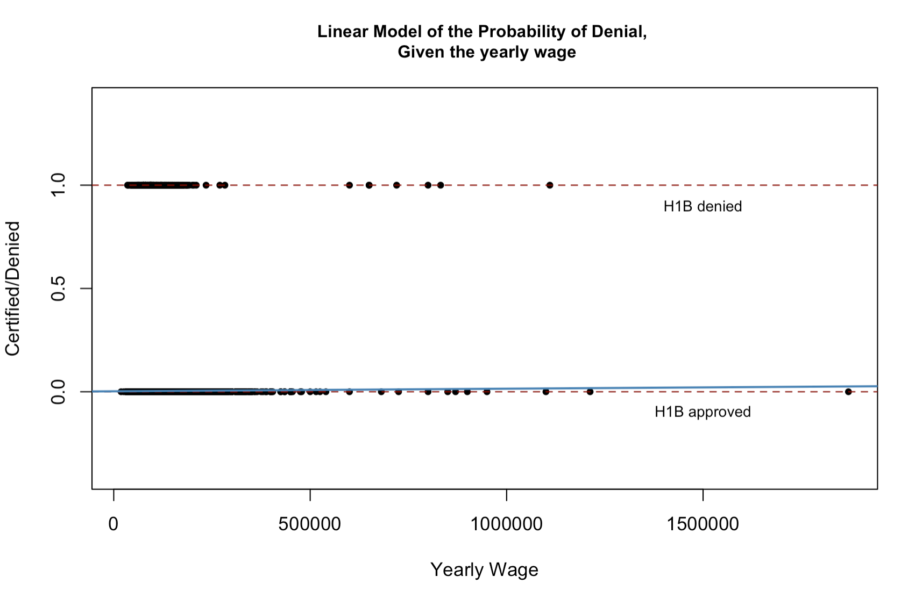

Slide 19
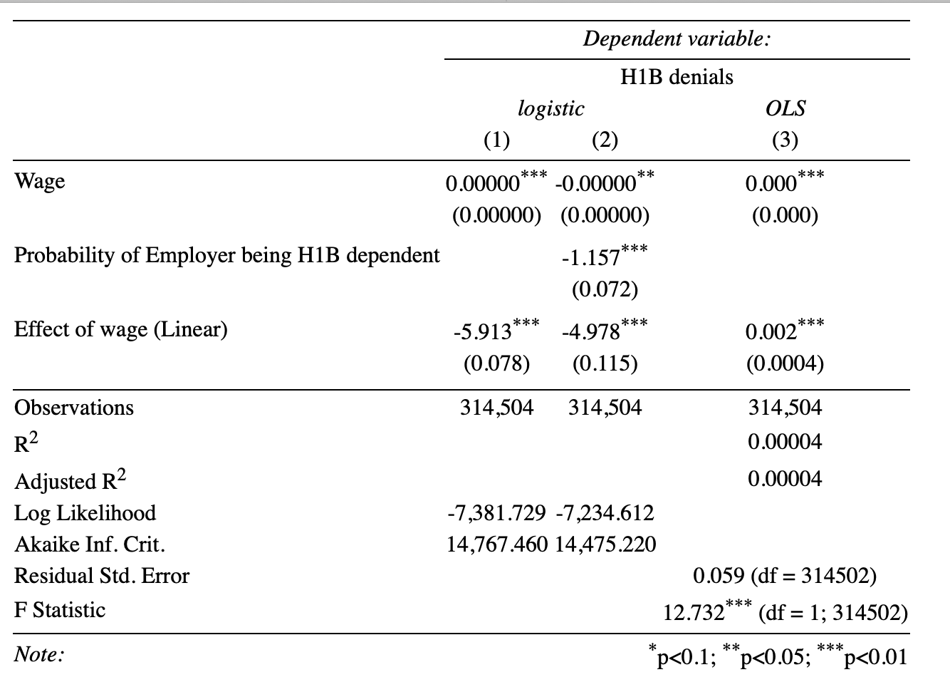

Slide 20

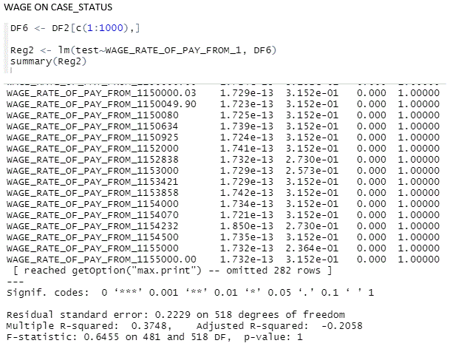
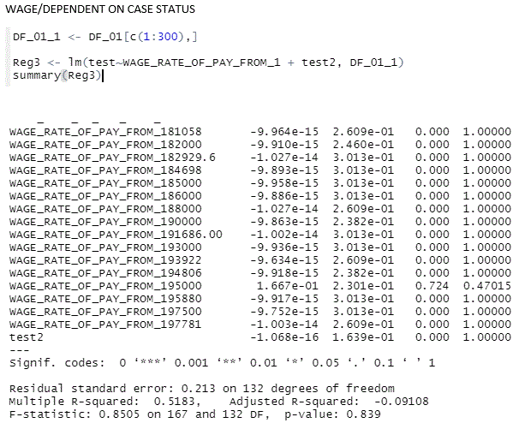
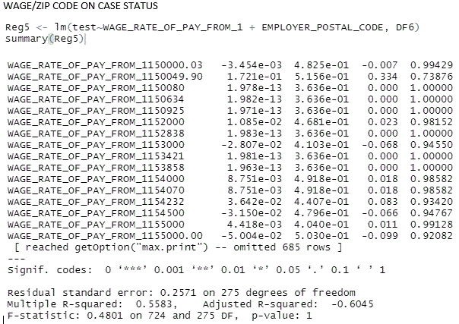
Understanding the importance of using the proper tool: Logistic regression vs. regular OLS linear regression
If one were to use the incorrect tool for the job, the results would not be accurate. Therefore, logistic regression is of paramount importance here.
Most important aspect to take note of here is that the p-values for the various regressions are not significant even though R and R^2 may show variance.

Slide 21

Results
Probability of acceptance reduces as the wage increases
Probability of denial is more in states with more number of applications (Due to the biases of data)
Probability of having an effect of denial is significant when the employer is H1B dependent

Slide 22

Conclusions

Slide 23

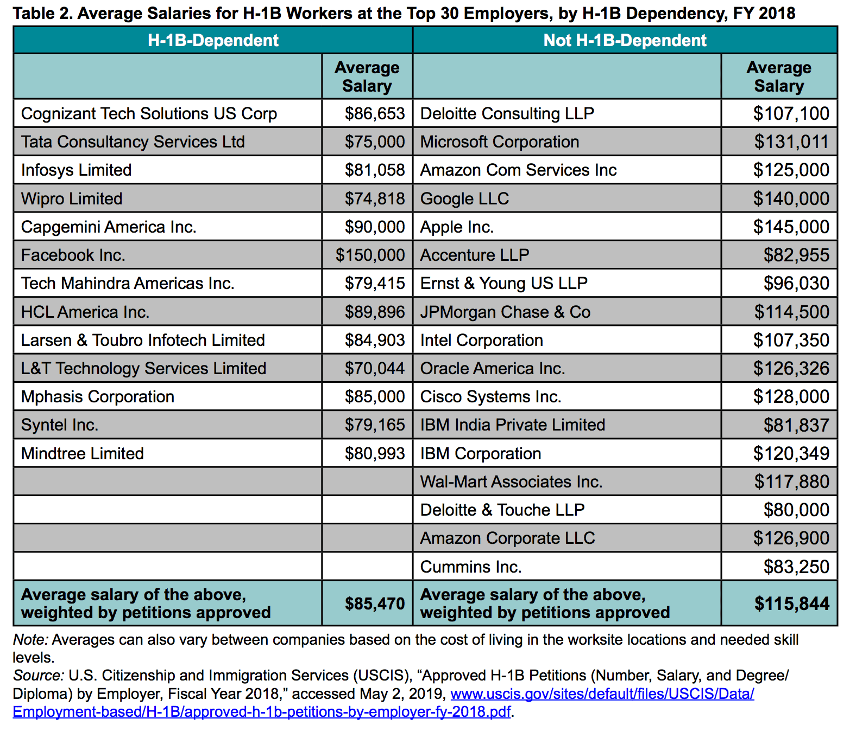
Outsourcing
Place your screenshot here
Outsourcing drives down costs like wages
Outsourcing firms apply for and use up majority of H1Bs
Outsourcing dominance impacts acceptance rate

Slide 24

Acceptance
Economic Considerations
Key states home to major tech employers, higher cost of living
Outsourcing firms contract across globe
Non-dependent firms pay higher, impacting acceptance, dependent firms apply for more, impacting acceptances
Political Considerations
H1B workers out-earn domestic workers in same positions
Globalization is on pause
COVID restrictions may override other immigration concerns
Congressional gridlock leaves matter up to President

Slide 25
Future Research
COVID-19
How did pandemic travel restrictions impact industries reliant on H1B visas?
Remote Work
How has increased acceptance of remote work impacted H1B process?
Political Changes
How will changing control of branches of government impact H1B process?
Economic Changes
How will downturn/upturn in economy impact H1B approvals?

Slide 26
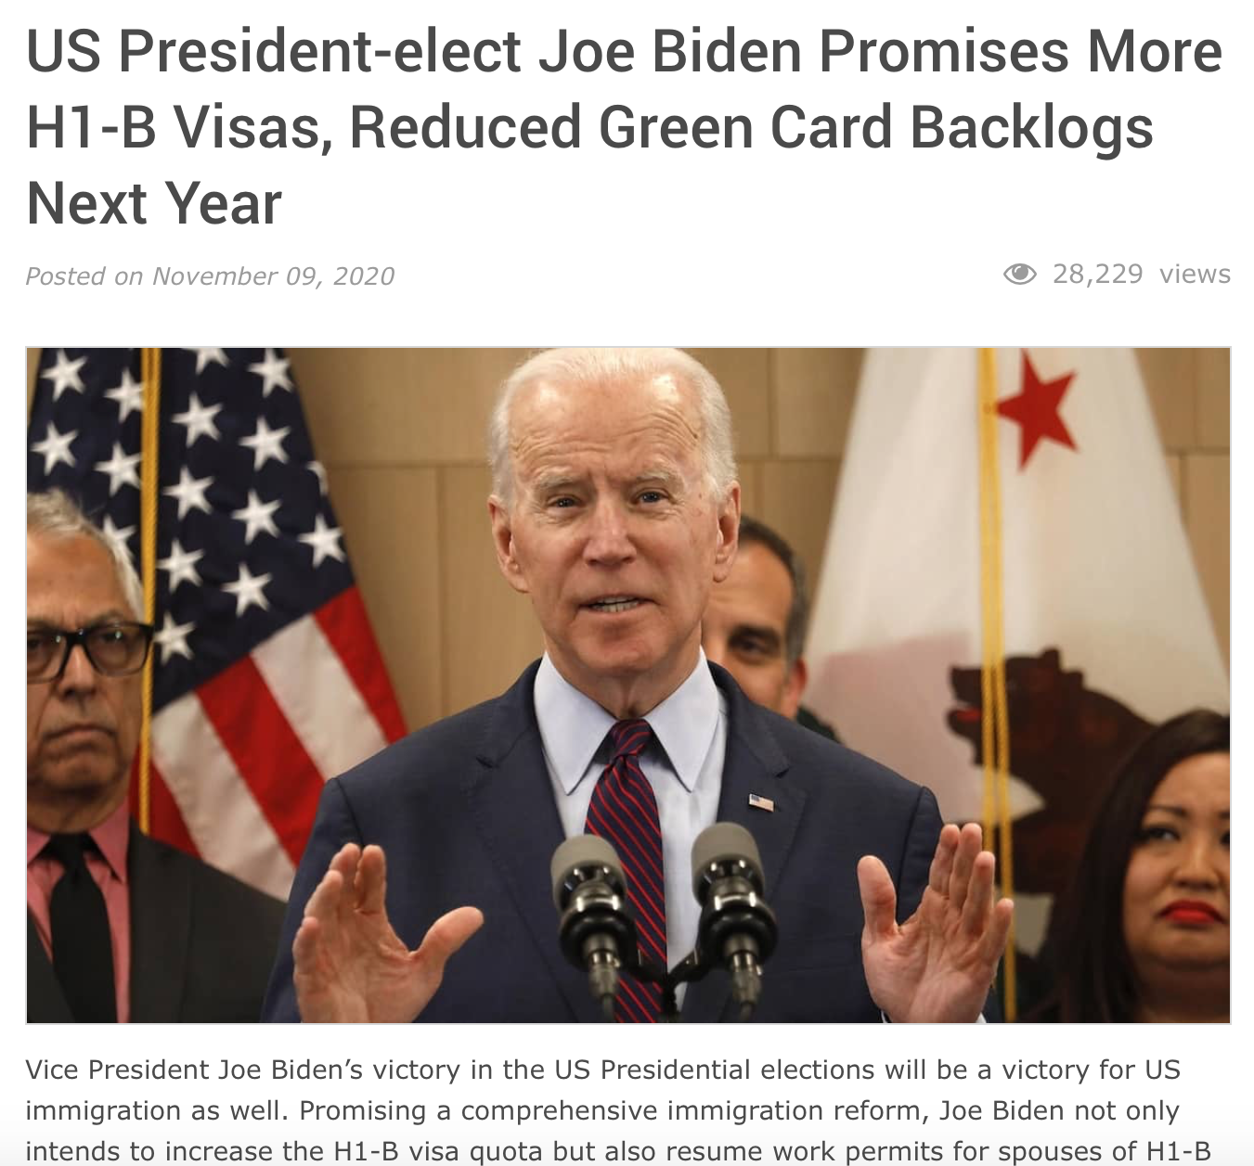
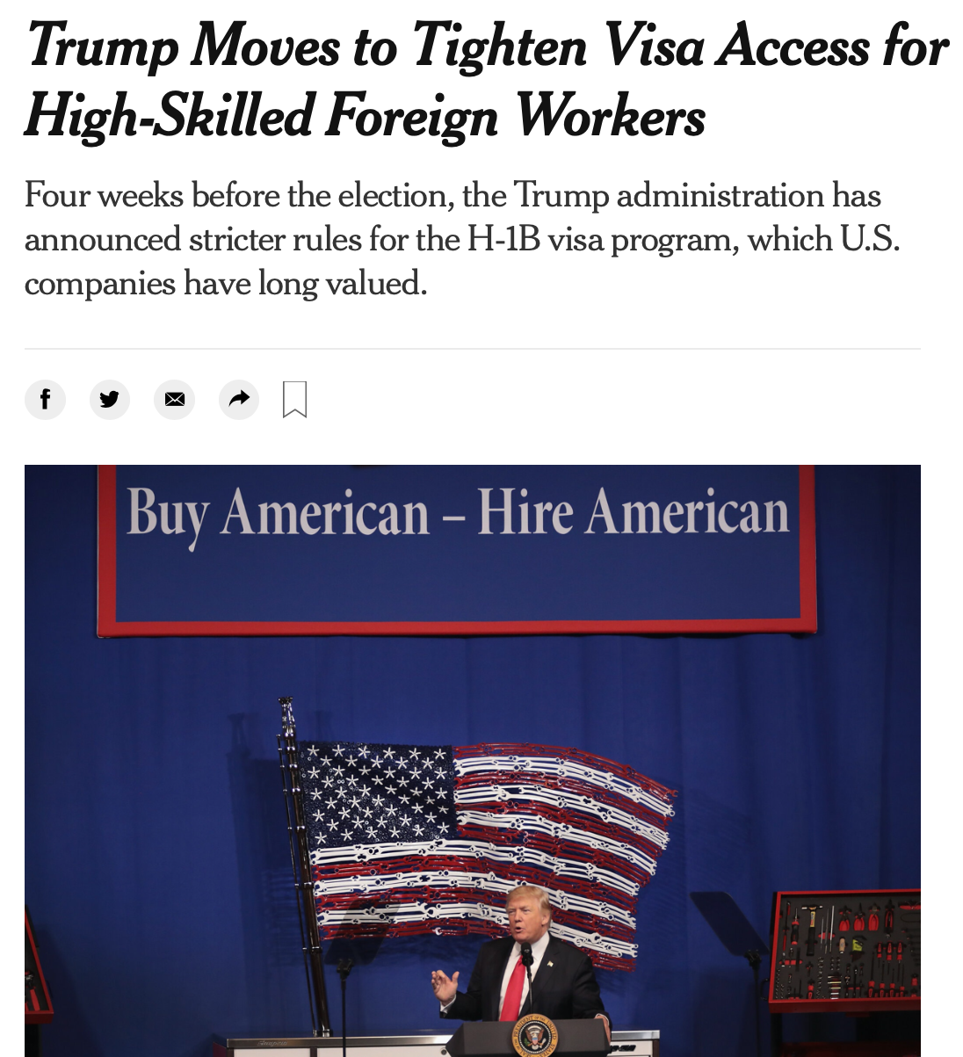
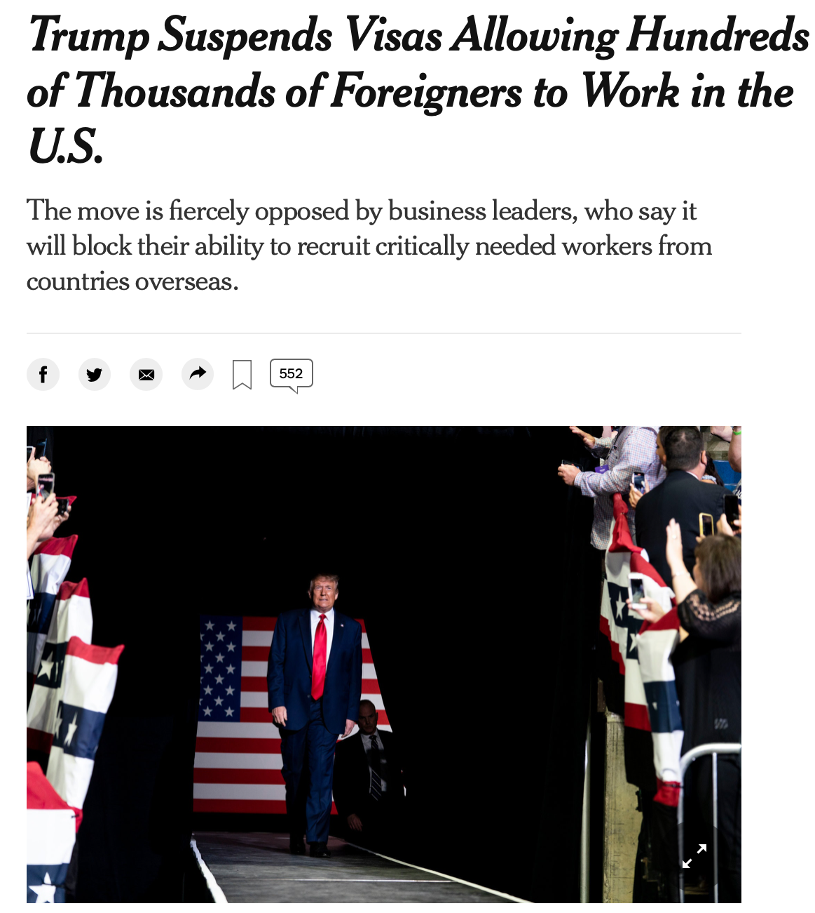
A positive approach…
November 2020
August 2020
June 2020

Slide 27
References
Thank You !
https://www.dol.gov/agencies/eta/foreign-labor/performance
https://www.uscis.gov/sites/default/files/document/reports/Characteristics_of_Specialty_Occupation_Workers_H-1B_Fiscal_Year_2019.pdf
https://www.forbes.com/sites/stuartanderson/2020/10/07/trump-administration-issues-two-new-rules-to-restrict-h-1b-visas/?sh=6be754965120
https://travel.state.gov/content/travel/en/us-visas/employment/temporary-worker-visas.html_
https://qz.com/india/1914167/us-election-2020-donald-trump-joe-bidens-h-1b-visa-plans/
https://www.stilt.com/blog/2020/08/restrictions-on-h1b-visa-holders-relaxed/
https://economictimes.indiatimes.com/nri/visa-and-immigration/us-has-just-over-580000-h-1b-visa-holders-says-uscis/articleshow/76676250.cms?from=mdr
https://www.investopedia.com/news/h1b-visa-issue-explained-msft-goog/
https://www.orfonline.org/expert-speak/biden-promised-expansion-h1b-visas-will-rife-challenges/
https://economictimes.indiatimes.com/nri/visa-and-immigration/joe-biden-plans-to-increase-h-1b-visa-limit-and-remove-country-quota-for-green-cards/articleshow/79108357.cms
https://hbr.org/2017/05/the-h-1b-visa-debate-explained

